Slide 1
Computer Networks
By Shailesh Kumar Khanchandani

Slide 2
Topics Covered
Digital Communication - Transmission of Digital Signals – Encoding, Impairments, Nyquist Bit Rate, Noise.
Performance – Bandwidth, Throughput, Latency, Bandwidth-Delay, Jitter.
Multiplexing and Transmission Media. Error Detection and Correction - Cyclic codes, Checksum, Forward error correction.

Slide 3
Data Rate
Data rate, also known as bit rate, refers to the rate at which data is transmitted over a communication channel and is typically measured in bits per second (bps) or multiples thereof (e.g., kilobits per second - kbps, megabits per second - Mbps, gigabits per second - Gbps).
The data rate represents the number of bits transmitted per unit of time and is a key metric in determining the speed and capacity of a communication system. It indicates how quickly data can be sent from one point to another and is influenced by various factors including the bandwidth of the channel, encoding techniques, modulation schemes, and the presence of noise or other impairments.
In digital communication systems, achieving a high data rate is often desirable to enable faster transmission of large volumes of data, support real-time applications such as video streaming and online gaming, and improve overall system performance and efficiency.
Data rate can vary widely depending on the specific technology and application. For example, data rates for wired communication technologies like Ethernet and fiber optic networks can range from Mbps to Gbps or even higher, while wireless communication standards such as Wi-Fi and cellular networks offer data rates that vary based on factors like signal strength, interference, and distance from the transmitter.

Slide 4
Digital Communication
Digital communication relies on the transmission of digital signals, and here's a breakdown of the key points you mentioned:
Encoding:
In digital communication, information (text, images, audio, etc.) is first converted into a stream of bits (0s and 1s).
Encoding techniques like Line Coding transform this binary data into a physical signal suitable for transmission over a channel (cable, fiber optics, etc.).
Different encoding schemes exist, each with its advantages for specific transmission mediums.

Slide 5
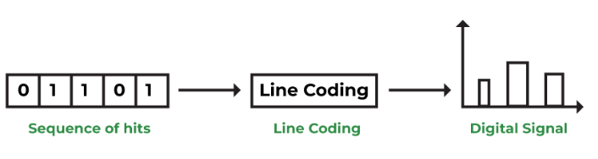
Line Coding
The process of converting binary data into a sequence of bits of the digital signal is known as Line coding. It is also known as digital PAM formats.
Need of Line coding:
We always come across different types of data such as text, numbers, graphical images, audio, and video. These all data are stored in computer memory in form of a sequence of bits. As shown below, line coding converts bit sequences into digital signals.
There are several techniques for converting an analog signal to a digital signal. However, digital data can also be obtained from sources such as computers. The information obtained from such a source is inherently discrete. When this type of discrete signal is transmitted over a band-limited channel, it becomes dispersed. That is, the pulses spread out and overlap each other, causing distortion. This distortion is known as inter-symbol interference.

Slide 6
Impairments
During transmission, various impairments can affect the signal's integrity:
Noise: Unwanted electrical or electromagnetic disturbances that introduce errors into the data.
Attenuation: Weakening of the signal strength over distance.
Interference: Undesired signals from other sources causing signal distortion.
Distortion: Altering the original signal's shape, potentially causing errors.

Slide 7
Nyquist Bit Rate
The Nyquist bit rate, named after Harry Nyquist, represents the maximum bit rate at which a signal can be transmitted without intersymbol interference (ISI) occurring.
According to Nyquist's theorem, the Nyquist bit rate (R) is given by: R = 2B * log2(L), where B is the bandwidth of the channel in hertz, and L is the number of signal levels used to represent data.
The Nyquist theorem states that to avoid ISI, the sampling rate must be at least twice the bandwidth of the signal.

Slide 8
Noise
Noise is a significant impairment in digital communication as it can flip bits (change 0s to 1s and vice versa).
Various techniques are employed to mitigate noise:
Error-correcting codes: Add redundant bits to the data stream allowing the receiver to detect and correct errors.
Signal amplification: Boosting the signal strength to improve its signal-to-noise ratio (SNR).

Slide 9
Performance Metrics
Bandwidth (bps):
Definition: Maximum theoretical data transfer rate of a communication channel.
Analogy: Size of a pipe, indicating the potential amount of data that can flow through it.
Importance: Determines the capacity of the network link, influencing how much data can be transmitted per unit time.
Throughput (bps):
Definition: Actual data transfer rate achieved under real-world conditions.
Analogy: Water flow rate through a pipe considering factors like friction.
Importance: Reflects the effective data transmission rate, accounting for factors such as network congestion, encoding overhead, and processing delays.
Latency (ms):
Definition: Time taken for a data packet to travel from sender to receiver.
Analogy: Travel time for a message, impacting responsiveness in real-time applications.
Importance: Affects the responsiveness of applications, with lower latency being desirable for real-time communication like video conferencing.

Slide 10
Bandwidth-Delay Product (BDP):
Definition: The product of bandwidth and latency, representing the amount of data that can be in transit on a connection at any given time.
Importance: Helps estimate transfer times for large files, considering both the available bandwidth and the delay in transmission.
Jitter (ms):
Definition: Variation in latency experienced by individual data packets.
Analogy: Variability in the time taken for packets to travel the same route.
Importance: Can disrupt real-time data streams like voice calls or video conferencing, causing audio or video glitches.
In summary, bandwidth represents the theoretical capacity of a network link, throughput reflects the actual data transfer rate, latency measures the time taken for data to travel, BDP combines bandwidth and latency to estimate transfer times, and jitter accounts for the variation in latency, which can impact real-time applications.

Slide 11
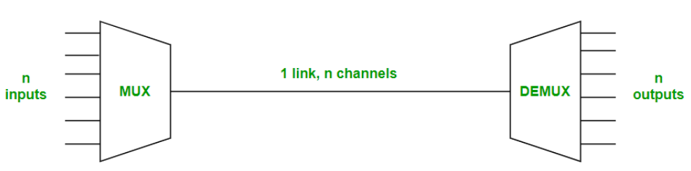
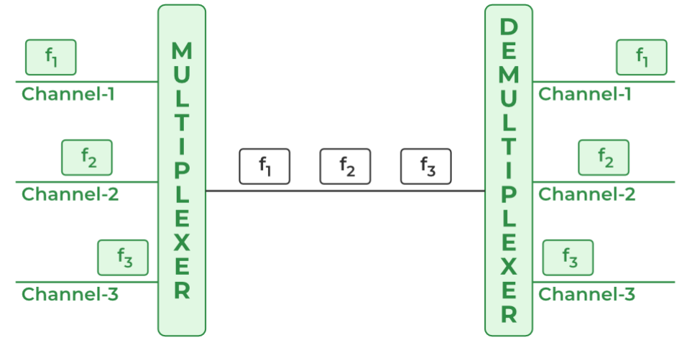
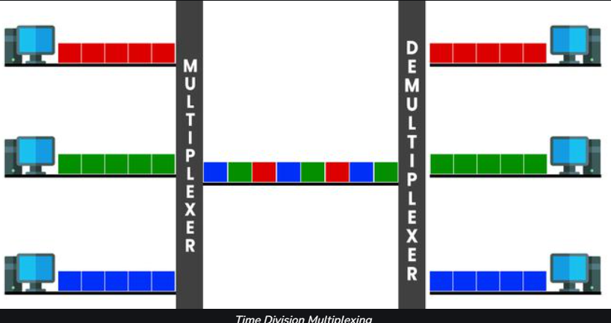
Multiplexing and Transmission Media
Multiplexing: The art of efficiently combining multiple data streams onto a single transmission medium. This optimizes bandwidth utilization and allows for concurrent communication across a shared channel.
Common techniques:
Frequency-Division Multiplexing (FDM): Divides the medium's frequency range into subchannels, each carrying a separate data stream. (e.g., Radio stations broadcasting on different frequencies)
Time-Division Multiplexing (TDM): Divides the medium's time into frames, with each frame allocated to a specific data stream for a short duration. (e.g., T1 carrier lines)

Slide 12
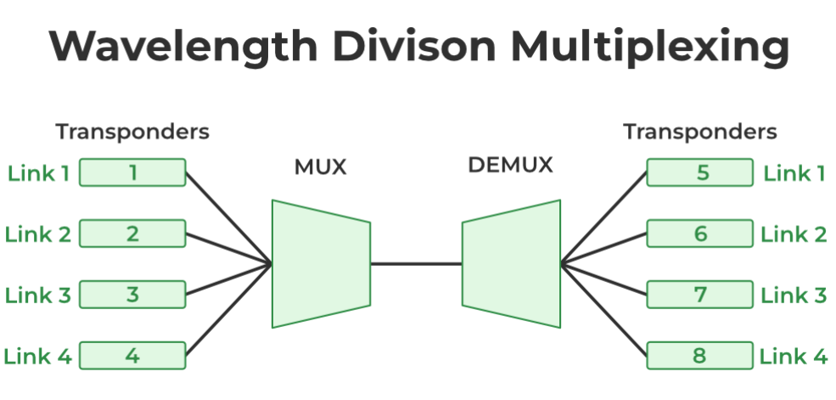
Multiplexing and Transmission Media
Wavelength-Division Multiplexing (WDM): Used with fiber optic cables, where multiple light signals at different wavelengths carry independent data streams. (e.g., Dense Wavelength-Division Multiplexing - DWDM)
Code-Division Multiplexing (CDM): Assigns unique codes to different data streams, allowing them to coexist on the same frequency or time slot. (e.g., Spread Spectrum communication)
Disadvantage of Multiplexing
Complexity: Multiplexing systems can be complex to design and implement. This can make them more expensive to deploy and maintain.
Single point of failure: If the multiplex system fails, all of the signals that are being transmitted over it will be lost.
Latency: Multiplexing can introduce latency into a signal. This is because it takes time to combine and separate the different signals.
Advantages of Multiplexing
Efficiency: Multiplexing allows for more efficient use of bandwidth. By combining multiple signals into one, you can avoid having to waste bandwidth on empty channels.
Cost-effective: Multiplexing can help to reduce costs by eliminating the need for additional physical media. For example, a phone company can use multiplexing to transmit multiple phone calls over a single fiber optic cable.
Scalability: Multiplexing can be used to scale networks to meet increasing demand. By adding additional channels to a multiplex, you can increase the capacity of the network.

Slide 13
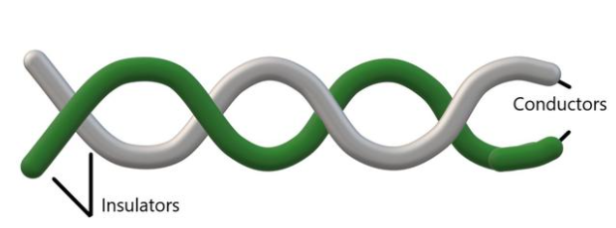
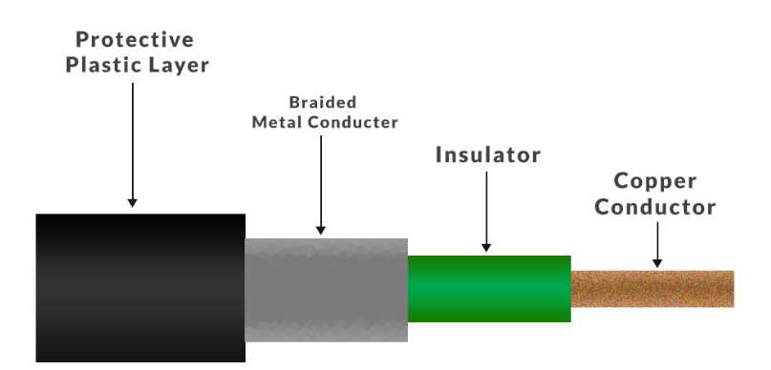
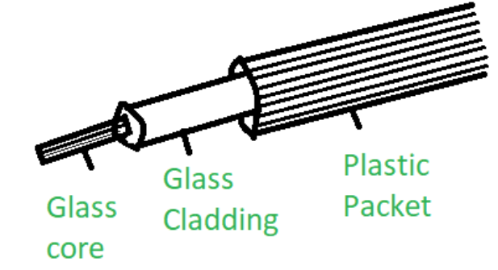
Multiplexing and Transmission Media
Transmission Media: The physical pathways through which data signals travel. The choice of medium depends on factors like transmission speed, distance, cost, and signal.
Guided Media: Confined physical paths offering protection and direction to signals. Examples:
Twisted-Pair Cable: Two insulated copper wires twisted together, suitable for short-distance data and voice transmission.
Coaxial Cable: A single conductor surrounded by an insulating layer and a braided outer shield, providing better noise immunity than twisted pair.
Fiber Optic Cable: Uses light pulses to transmit data through thin glass fibers, offering high bandwidth and low attenuation for long-distance communication.

Slide 14
Multiplexing and Transmission Media
Unguided Media: Open spaces through which electromagnetic waves propagate data signals. Examples:
Satellite Communication: Data transmitted via satellites orbiting Earth, enabling communication across vast distances.
Microwave Communication: Uses high-frequency radio waves for short-range, line-of-sight transmission. (e.g., Wi-Fi)
Radio Communication: Employs lower-frequency radio waves for broadcasting and long-range communication. (e.g., Cellular networks)

Slide 15
Error Detection and Correction
Errors in Transmission: Data errors can happen due to noise, interference, or signal degradation during transmission. These errors can corrupt the transmitted information.
Error Detection: Techniques to identify errors during data transfer.
Checksum: A simple method where the sender calculates the sum (or a mathematical function) of the data and appends it to the message. The receiver performs the same calculation on the received data and compares it with the received checksum. If they differ, an error is detected.
Cyclic Redundancy Check (CRC): A more robust method that uses a mathematical algorithm to generate a CRC code based on the data. The sender appends the CRC code to the message. The receiver performs the same calculation on the received data and generates a CRC code. If the received and calculated CRC codes match, the data is likely error-free.

Slide 16
Error Detection and Correction
Error Correction: Techniques to not only detect but also rectify errors without requiring retransmission.
Forward Error Correction (FEC): The sender adds redundant bits to the data using mathematical codes. These redundant bits allow the receiver to identify and potentially correct errors without needing the sender to resend the data. FEC is particularly useful for real-time applications where retransmission delays are unacceptable. (e.g., Streaming video)
Automatic Repeat Request (ARQ): A retransmission-based error correction method. The receiver detects errors and requests the sender to resend the corrupted data packets. ARQ ensures reliable data delivery but introduces delay due to retransmissions.

Slide 17
Choosing the Right Technique
The choice between error detection and correction depends on the application's requirements:
For reliable data delivery: Use FEC for real-time applications where delays are critical, or ARQ for high-accuracy data transfer.
For low overhead: If bandwidth efficiency is a concern and occasional errors are acceptable, error detection (checksum or CRC) might be sufficient.

